Slide 1
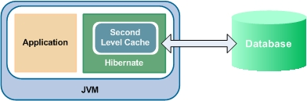
Cache management
Presented by
Purushottam Kumar

Slide 2
What is Caching
In most of the web applications, data is retrieved from the database.
The database operation is expensive and time consuming.
Present-day web applications are data intensive and first response time is the basic criteria for success.
If the web application is frequently accessing the database for each request then its performance will be slow.
As a result, many web applications are following different design techniques for reducing latency times and scale up.
"Caching is a temporary location where we store data which we need it frequently, as the original data is expensive to be fetched, so we can retrieve it faster."
There are different caching mechanism and frameworks. Some of them are listed below.

Slide 3
continued
Caching Mechanisms:
Timed Cache
HashMap/HashTable/LinkedHashMap based Cache
Cache based on Pooling
Caching Algorithms:
Least Frequently Used (LFU)
Least Frequently Used (LRU)
Most Recently Used (MRU)
Adaptive Replacement Cache (ARC)
First in First out (FIFO)
Timed Based
Caching Frameworks:
· Java Caching System (JCS) –Most frequestly used. · Ehcache · OSCache · Cache4J · ShiftOne · WhirlyCache · SwarmCache · JBoss Cache

Slide 4
Benefit of Caching
Memory management
Disk overflow (and defragmentation)
Thread pool controls
Element grouping
Minimal dependencies
Quick nested categorical removal
Data expiration (idle time and max life)
Extensible framework
Fully configurable runtime parameters
Region data separation and configuration
Fine grained element configuration options
Remote synchronization
Remote store recovery
Element event handling
Remote server chaining (or clustering) and failover

Slide 5
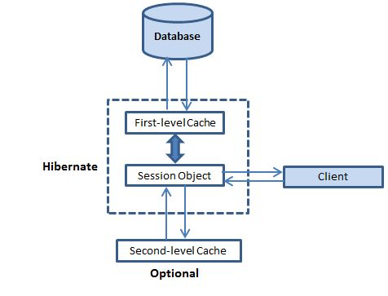
Caching in Hibernate:
First Level , Second Level Cache and the query cache in Hibernate

Slide 6
The first-level cache: The first level cache type is the session cache. The session cache caches object within the current session but this is not enough for long level i.e. session factory scope.
The second-level cache: The second-level cache is called 'second-level' because there is already a cache operating for you in Hibernate for the duration you have a session open. A Hibernate Session is a transaction-level cache of persistent data. It is possible to configure a SessionFactory-level cache on a class-by-class and collection-by-collection basis.
Hibernate uses first-level cache by default and you have nothing to do to use first-level cache. Let's go straight to the optional second-level cache. Not all classes benefit from caching, so it's important to be able to disable the second-level cache.
The 'second-level' cache exists as long as the session factory is alive. The second-level cache holds on to the 'data' for all properties and associations (and collections if requested) for individual entities that are marked to be cached.

Slide 7
Configuration required in the Hibernate
In hibernate configuration file (hibernate.cfg.xml) we wrote the following line. For Disabling the second level of cache we have to made following change to hibernate configuration file.
<!-- Disable the second-level cache -->
<property name="cache.provider_class">org.hibernate.cache.NoCacheProvider</property>
For Enabling the second level of cache we have to made following change to hibernate configuration file.
<!-- Enable the second-level cache -->
<property name="cache.use_second_level_cache">true</property>
<propertyname="cache.provider_class">org.hibernate.cache.EhCacheProvider</property>
true org.hibernate.cache.EhCacheProvider 1.

Slide 8
1.Cache Strategy using with Annotation as some changes made to the Model class also.
@Cacheable
@Cache(usage = CacheConcurrencyStrategy.READ_ONLY)
@Entity
@Table(name="STUDENT")
public class Student implements Serializable
{
2. Cache Strategy using with Mapping file(.hbm.xml) .
<HIBERNATE-MAPPING>
<CLASS name="Student" table="STUDENT">
This class contains the student detail.
<CACHE usage="read-only">
<ID type="java.lang.Long" name="id" column="ID">
<GENERATOR class=native>
</GENERATOR></ID>
<property type="java.lang.String" name="studentName" column="STUDENT_NAME">
<property type="java.lang.String" name="course" column="lCOURSE">
<property type="java.lang.Long" name="rollNumber" column="ROLL_NUMBER">
</property></property></property></CACHE></CLASS>
</HIBERNATE-MAPPING>

Slide 9
Query Level caching
You can also enable query caching. To do so configure it in your hbm.xml:
<property key="hibernate.cache.use_query_cache">true</property>
And where queries are defined in your code, add the method call setCacheable(true) to the queries that should be cached:
sessionFactory.getCurrentSession().createQuery("...").setCacheable(true).list();
By default, Ehcache will create separate cache regions for each entity that you configure for caching. You can change the defaults for these regions by adding the configuration to your ehcache.xml. To provide this configuration file, use this property in hibernate configuration:
<property name="net.sf.ehcache.configurationResourceName">/ehcache.xml</property>
And use below configuration to override the default configuration:
<cache
name="com.somecompany.someproject.domain.Country"
maxElementsInMemory="10000"
eternal="false"
timeToIdleSeconds="300"
timeToLiveSeconds="600"
overflowToDisk="true"
/>

Slide 10
Thank You..

